Slide 1
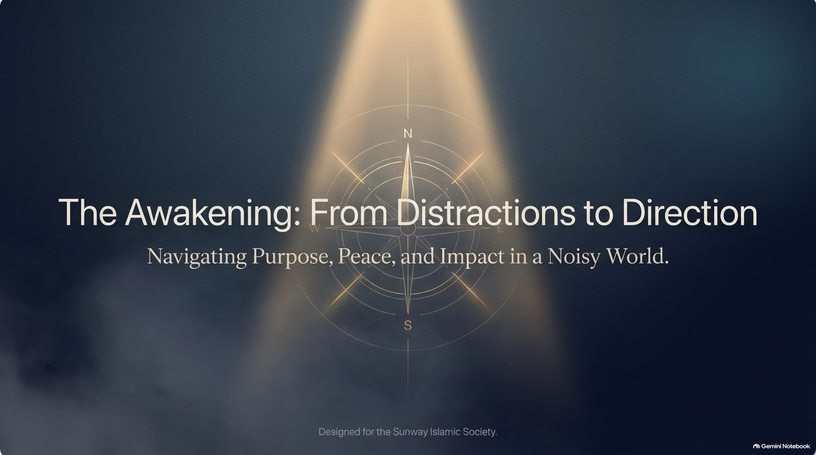

Slide 2
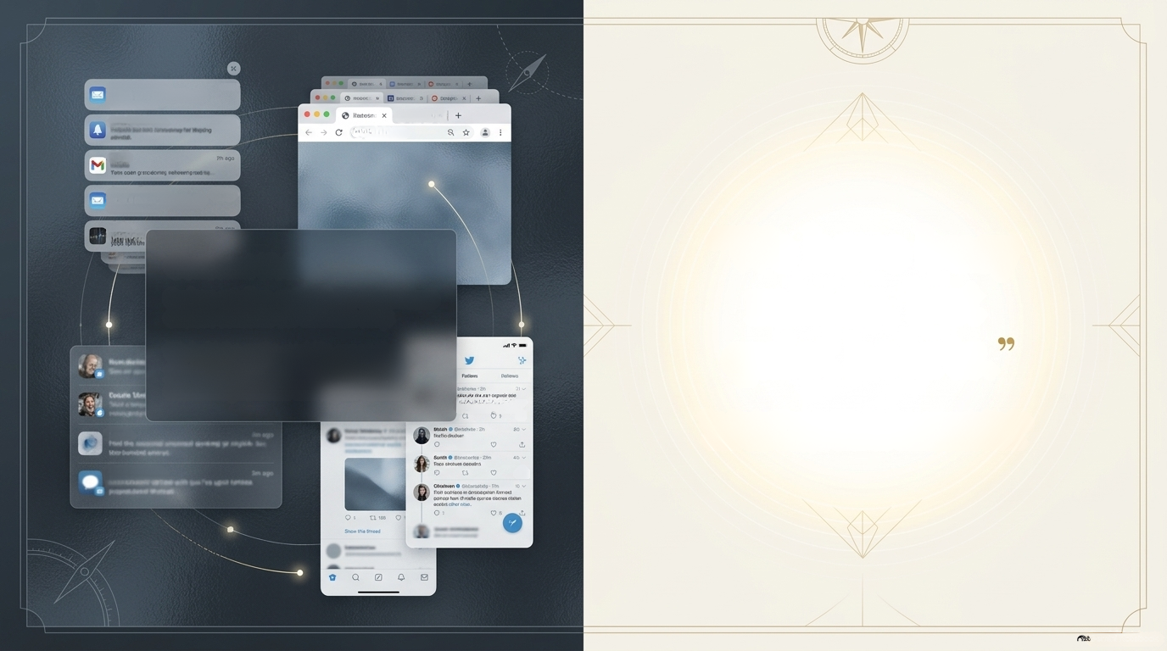
Push Notifications
Indices sorting, netifications, and
Imitiess choices.
now
Push Notifications
3m ago
G Web so x
⚫website.com
Gmail
Push Nocifications
Eadless serditing, notifications, and
2 ago
limitless choices.
Stock
"We have busy
minds, but
quiet hearts.
Woose is che
Constant Noise.
Endless scrolling, notifications, and limitless
choices consume our attention daily.
We hold the entire world in our pockets,
yet we are constantly overwhelmed by
academic pressures and digital noise.
Coute 1
on cotange coe
detes celd Sumele hace
2
The Student Paradox: We are more connected to the
world than ever, yet often feel disconnected inside.
Naske
£3
App Documents
2
0
Notes:
The World is in your pocket
oThe modern reality of constant digital connectivity.
oThe paradox of being connected to the whole world while feeling disconnected inside.
oNormalizing the mental clutter and fatigue students feel every day.

Slide 3
Push Notifications
Indices sorting, netifications, and
Imitiess choices.
now
Push Notifications
3m ago
G Web so x
⚫website.com
Gmail
Push Nocifications
Eadless serditing, notifications, and
2 ago
limitless choices.
Stock
Woose is che
DISTRACTION?
What’s yours?
Coute 1
Timer
on cotange coe
detes celd Sumele hace
2
Naske
£3
App Documents
2
0
Notes:
The World is in your pocket
We aren't lazy; we are just overwhelmed. Our minds are constantly busy, but our hearts feel quiet and tired.

Slide 4
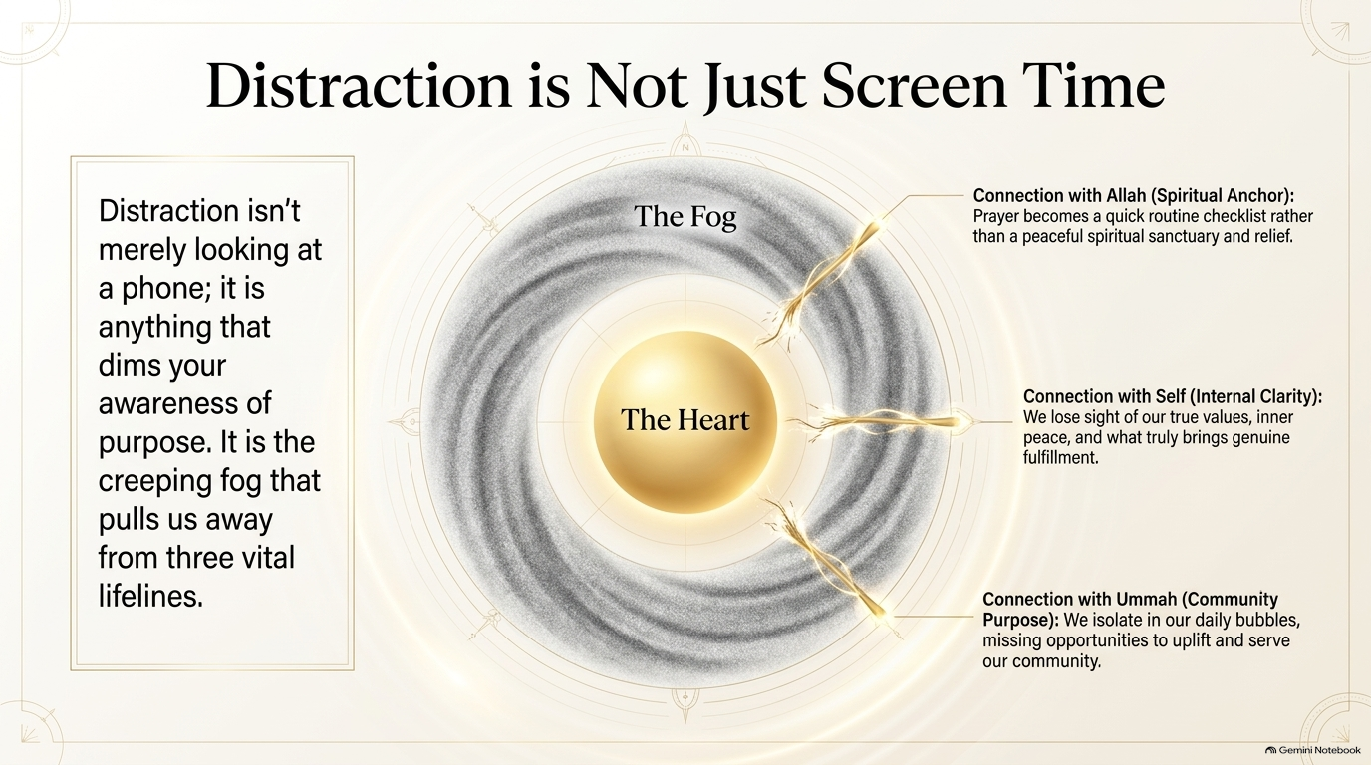
Notes:
oReframe distraction: Its not just about spending hours on social media or playing games.
oDistraction is anything that dims your awareness of who you are and why you’re here.
oThe three core connections we lose track of when we drift.

Slide 5
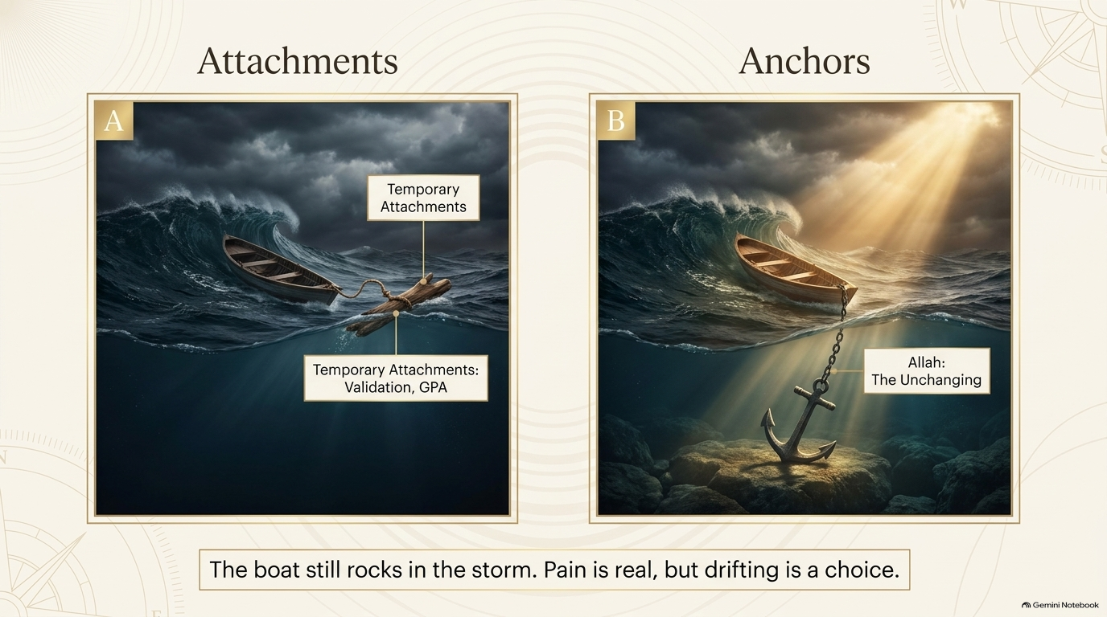
AL-BAQI’
Timer
Notes:
Anchoring the Heart
Write it down...
What's your attachment?
What weighs you down?

Slide 6
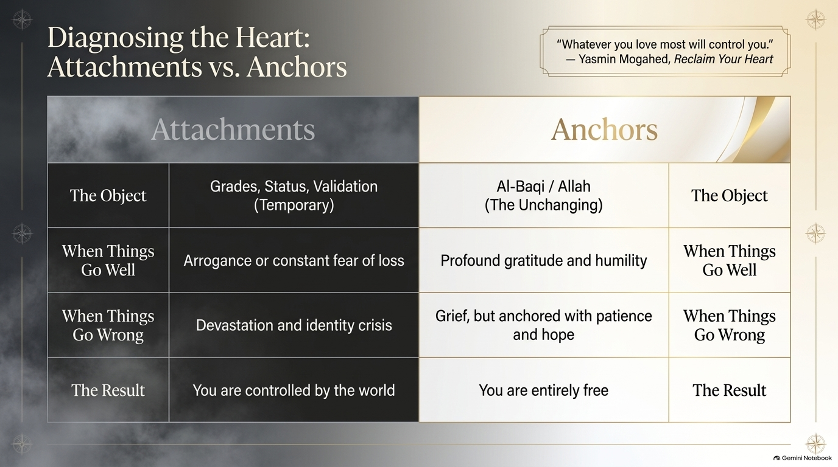
Notes:
oHeart attachments: What happens when we tie our self-worth to temporary things?
oGrades, social validation, and perfectionism as unstable anchors.
oTrue stability comes from anchoring to Al-Baqi (The Everlasting).

Slide 7
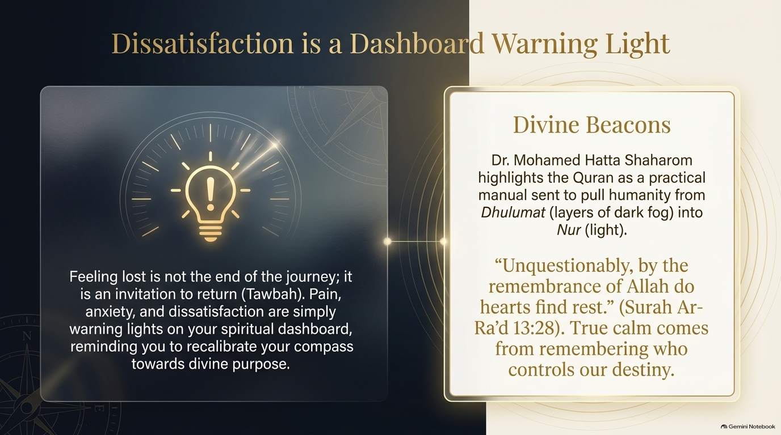
Notes:
When the check-engine light comes on in a car, you don't beat up the car; you thank the light for telling you to pull over and check the oil. Emptiness, anxiety, and burnout are just spiritual check-engine lights. They are gentle invitations from Allah saying: 'Come back home. You were made for more than just surviving daily stress.'"
Guidance from Above
"In his book Beacons, Dr. Mohamed Hatta Shaharom who is a psychiatrist and scholar explores how the Quran isn't just a book of ancient history or rules. It is a practical guide for modern psychological wellness.
The Quran describes itself as bringing us out of Dhulumat (layers of darkness) into Nur (light). In Surah Ar-Ra'd, Allah tells us: 'Unquestionably, by the remembrance of Allah do hearts find rest.' When your mind is racing at midnight over assignments, true calm doesn't come from another hour of scrolling; it comes from remembering who is ultimately in control of your destiny."

Slide 8

Finding Your Sacred Purpose
Ikigai answers what gives life meaning; Islam answers why and for whom.
What you
love
Niyyah
What brings
sustenance
What you're
good at
KhiDMAH
What the
world needs
Niyyah (Intention) & Khilafah (Stewardship)
When placed inside the container of pure Niyyah, every skill learned at Sunway University-
business, design, tech-transforms from a secular task into Ibadah (an act of worship).
Notes:
Alignment — Finding Your Ikigai
Have you heard of IKIGAI?
It translates roughly to 'your reason to jump out of bed in the morning.'
The Japanese noticed that the happiest, longest-living people are those who align four things:
what they love doing,
what they are good at,
what the world actually needs, and
what can sustain their livelihood.
When you find the intersection of those four, work stops feeling like a chore and starts feeling like fulfillment.
But as Muslims, there is one crucial dimension we need to add to this."
"If we take Ikigai and view it through the lens of Islam, the central intersection becomes Niyyah (intention) and Khidmah (service for Allah's sake).

Slide 9
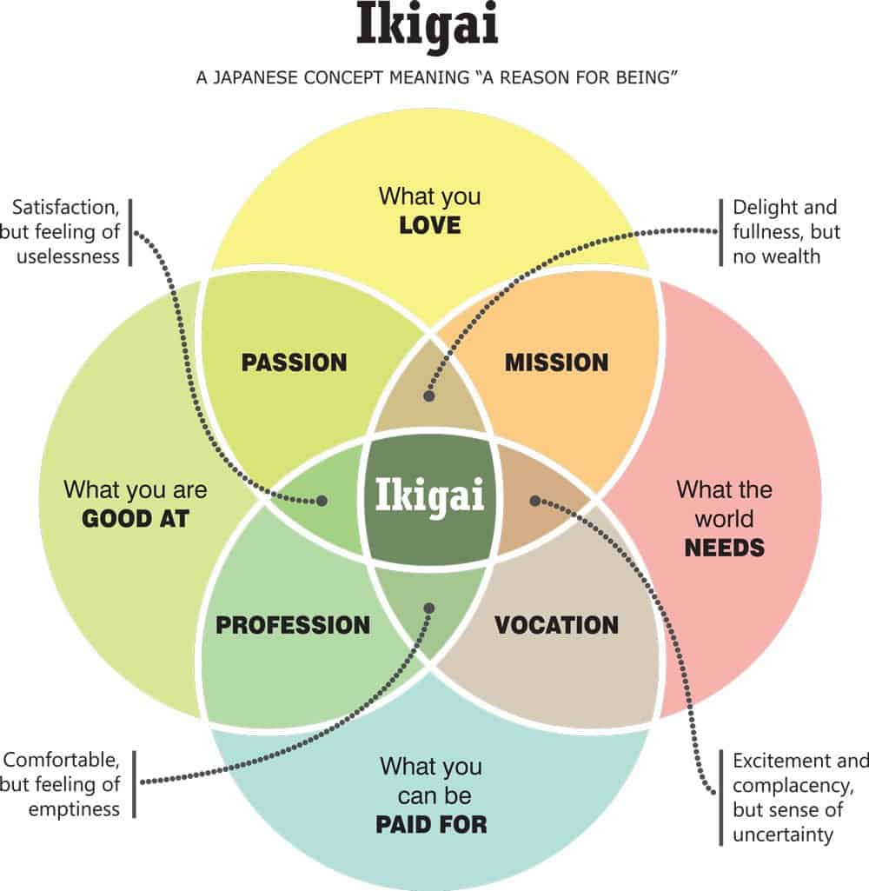
IKIGAI | ISLAMIC CONCEPT | Key Difference / Integration
Reason for Being | Purpose of Creation (Quran 51:56) | Ikigai is self-driven; Islam grounds human purpose in worshiping God through righteous actions.
Flow State | Khushu' (Mindful Presence) | Deep immersion in work or prayer without distraction, operating with presence before God.
Community (Moai) | Ummatic Ties & Silaturrahim | Mutual social support and strengthening ties of kinship for collective well-being.
Moderation (Hara Hachi Bu) | Sunnah of Eating | The Prophet's instruction to fill the stomach with 1/3 food, 1/3 water, and 1/3 air.
Resilience (Wabi-Sabi) | Sabr & Tawakkul | Patience through trials, acceptance of impermanence, and trust in divine decree (Qadar).
Notes:
Alignment — Finding Your Ikigai
Aligning Ikigai with an Islamic framework bridges a psychological model of self-actualization with a faith-based worldview focused on spiritual purpose (Ubudiyyah) and earthly stewardship (Khilafah). While Ikigai asks "What gives me joy and purpose in this life?", the Islamic lens expands this to "How does my purpose serve my Creator, benefit creation, and secure my outcome in the Hereafter (Aakhirah)?"
four pillars of Ikigai translate directly into foundational Islamic concepts:
What you LOVE → Niyyah (Intention) & Ihsan (Excellence)
In Islam, doing what you love is elevated by sincere intention. When you align your natural interests with pleasing God (Rida Allah), everyday passions become acts of worship (Ibadah).
What you are GOOD AT → Amanah (Trust) & Itqan (Mastery)
Your innate talents and skills are gifts given by God on trust (Amanah). The Prophet Muhammad taught that God loves when a person performs a task with Itqan (thoroughness and mastery).
What the WORLD NEEDS → Khilafah (Stewardship) & Naf' (Benefit to Others)
Islam places high value on social utility. The Prophet stated, "The best of people are those who are most beneficial to others." Serving societal needs aligns with the Islamic duty of stewardship over the earth and community.
What you can be PAID FOR → Halal Rizq (Lawful Sustenance)
Earning a living is not purely secular in Islam; seeking Halal (permissible) income to support oneself and family is considered a spiritual obligation and a form of jihad (striving).
The "5th Element": Adding the Eternal Lens
In the conventional Ikigai framework, the center point yields earthly happiness and financial sustainability. From an Islamic perspective, an essential dimension sits above and through all four circles: Pleased with Allah, and Allah pleased with them (Radiyallahu 'anhum wa radoo 'anhu).
__________________________________
An "Islamic Ikigai" ensures that:
The work remains strictly within Halal boundries.
The ultimate objective extends beyond temporal satisfaction to Sadaqah Jariyah (ongoing charity) that yields rewards in the afterlife.

Slide 10

The Energy of Youth
Notes:
The Energy of Youth
"In his letter Dear Youth, Hassan Al-Banna addresses young university students just like us. He points out that throughout human history, every meaningful change, every movement of compassion, and every community transformation was built on the shoulders of youth.
Why? Because youth is the time when your heart is most alive, your minds are sharpest, and your capacity to care is at its peak. You don't need a title, a degree, or decades of experience to make a difference. You just need the willingness to show up."
Being a Beacon on Campus
So what does an awakened Muslim look like right here on the campus?
It looks like someone who shows up to group projects on time with Ihsan (excellence). It looks like someone who notices a freshman sitting alone in the cafeteria and asks to join them. It looks like setting up a simple study circle before exams to help struggling classmates. It looks like organizing a small food drive or a cozy night chat. Faith in Sunway isn't about being loud; it’s about being a warm, dependable light wherever you step."

Slide 11

The Spectrum of Living
Benefiting.
Practicing.
Fulfilling basic obligations. The
heart is peaceful, personal, but the
impact remains self-contained.
Living out the principle of Khayrun Nas
("The best of people are those who benefit
others"). Transforming your energy into
active campus service.
Existing.
Surviving the daily routine of
campus life, deadlines, assignment
stress, and passive scrolling.
From Internal Focus to External Service
Notes:
From Passive Practice to Active Purpose
"All of you here inshaAllah are decent people. We attend classes, we perform our daily prayers when required, we don't break major rules—we live at Level 2: 'Practicing.'
And that is a good foundation! But Islam didn't come to turn us into isolated practice units who only care about our own spiritual bubbles.
Prophet Muhammad (pbuh) said: 'The best of people are those who bring the most benefit to others.'
True spiritual awakening happens when you move from 'How do I protect myself?' to 'How can I lift someone else up today?'"
Being a Beacon on Campus
So what does an awakened Muslim look like right here on the Sunway campus?
It looks like someone who shows up to group projects on time with Ihsan (excellence). It looks like someone who notices a freshman sitting alone in the cafeteria and asks to join them. It looks like setting up a simple study circle before exams to help struggling classmates. It looks like organizing a small food drive or a cozy night chat. Faith in Sunway isn't about being loud; it’s about being a warm, dependable light wherever you step."

Slide 12
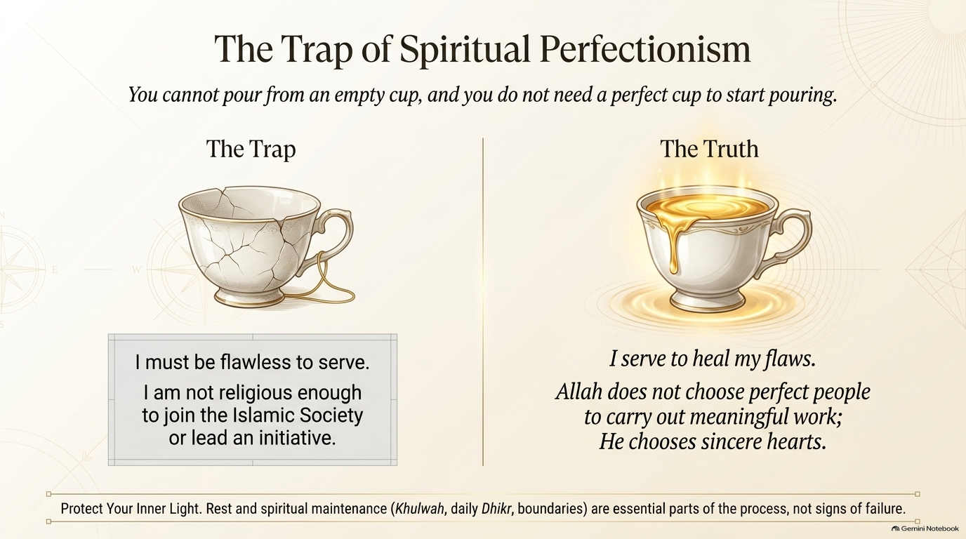
Notes:
Overcoming "Not Good Enough"
"One of the biggest reasons students hesitate to join Islamic Society activities is a quiet thought in their head: 'I’m not religious enough. My faith has ups and downs. Who am I to contribute?'
In the book "I Lost My Way" by, Yasmin Mogahed, she addresses this head-on:
Allah does not choose perfect people to do good work; He chooses sincere hearts. You don't join community service because you’re a saint; you join because serving others is how Allah heals your heart. Your flaws don't disqualify you—they make you human and relatable."
Mental Health & Spiritual Wellbeing
"Now, a very important reminder: You cannot pour from an empty cup or a broken one. In both Beacons and Reclaim Your Heart, the authors remind us that before you go out to serve the world, you must guard your own heart.
Activism without spiritual recharge leads to burnout and bitterness. If you join projects or serve society, make sure your daily prayers, your quiet moments of Dhikr, and your rest are non-negotiable.
Taking a break to protect your mental health isn't quitting; it's maintenance so you can keep serving long-term."

Slide 13
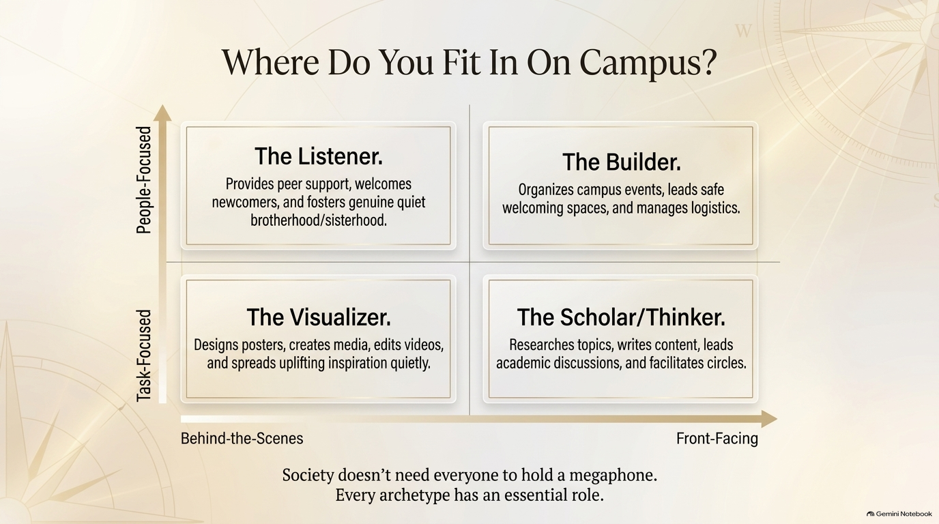
Notes:
We all have different talents and personalities, and that is by design.
oIf you are creative, you are The Visualizer—we need your graphic design, your storytelling, your video editing to share uplifting messages.
oIf you love logistics, you are The Builder—you make events run smoothly behind the scenes.
oIf you are an introvert who loves deep chats, you are The Listener—we need you to sit with someone who feels lonely on campus.
oIf you love reading, you are The Thinker.
You don't have to change who you are to be active; you just bring your authentic self to the table."

Slide 14
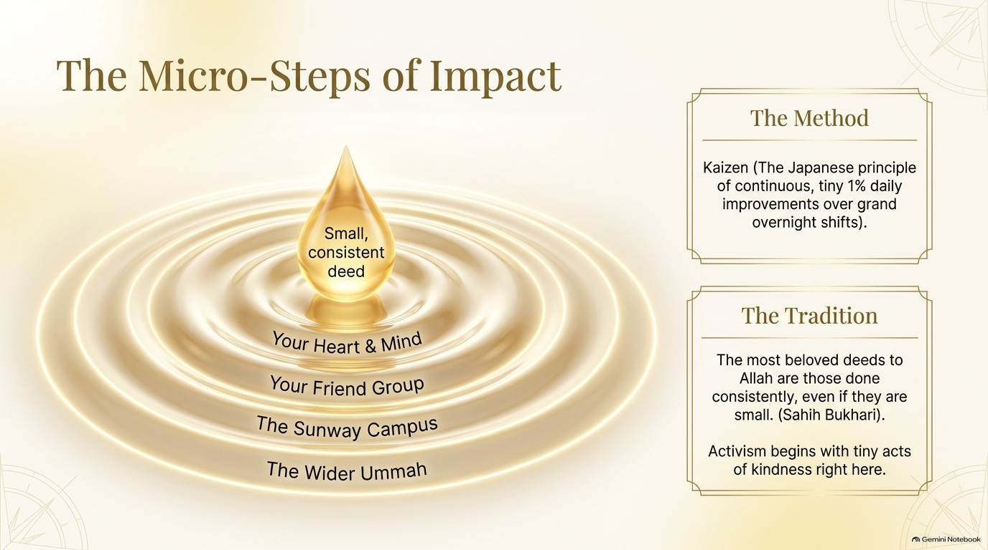
Notes:
The Ripple Effect of Small Actions
"When I say the word 'activism' or 'getting involved,' some of you might panic thinking, 'I don't have time for intense meetings or mega-events.' But thats a misconception.
In Japan, they call it Kaizen; the power of tiny, 1% improvements.
In Islam, the Prophet (pbuh) taught us that the deeds most beloved to Allah are those that are consistent, even if they are small.
Activism in Sunway Islamic Society doesn't mean changing the world tomorrow. It means doing small, heartfelt things for your fellow students every single week."

Slide 15
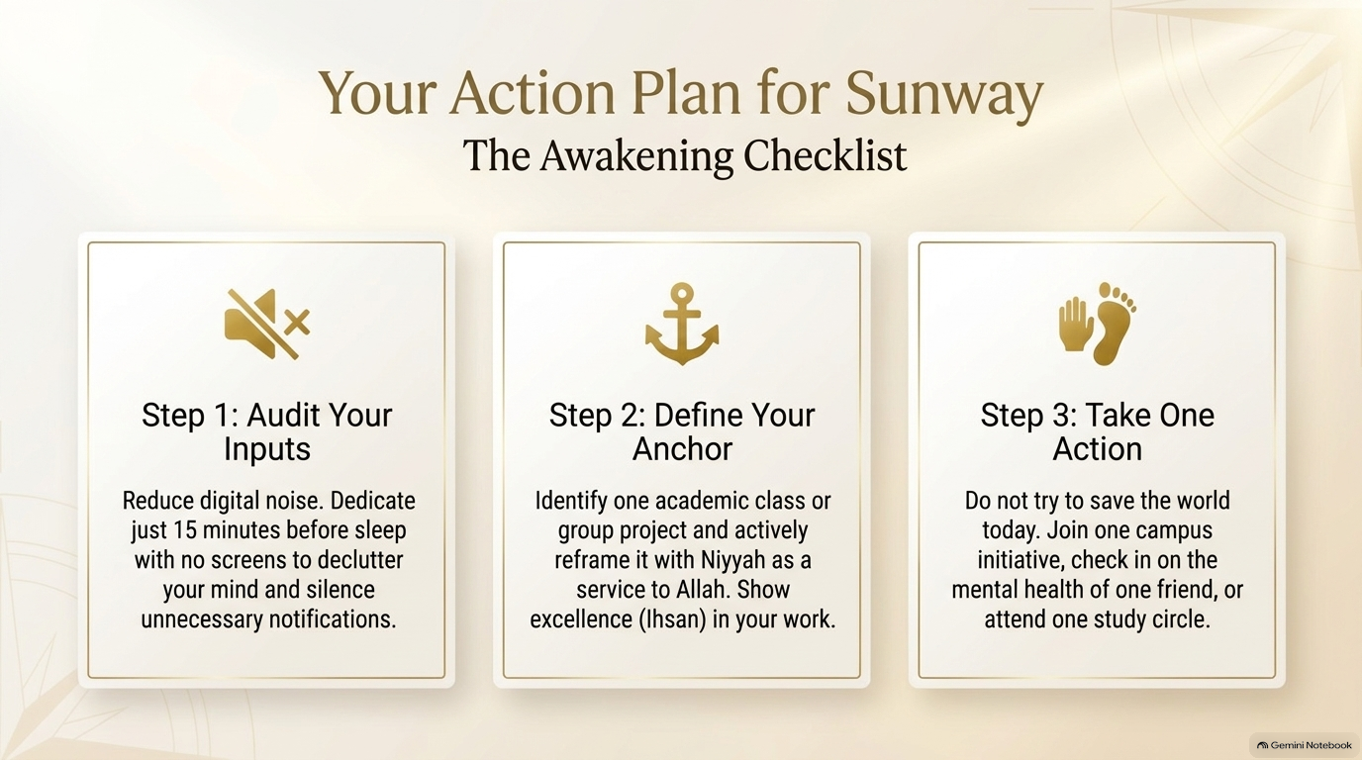
Notes:
Three Practical Shift Steps
"Let's make this super practical before we wrap up. Here are three tiny steps you can start tonight:
1.Audit your inputs: Take 15 minutes before sleep tonight without your phone. Let your brain declutter and talk to Allah in plain English or BM.
2.Define your anchor: Before you open your laptop tomorrow for classes, pause for 5 seconds and say: 'O Allah, I am studying this so I can be useful to others.'
3.Take one micro-step: Say 'yes' to assisting with just one small task in the society this intake—whether it’s designing one poster or helping carry a chair."

Slide 16
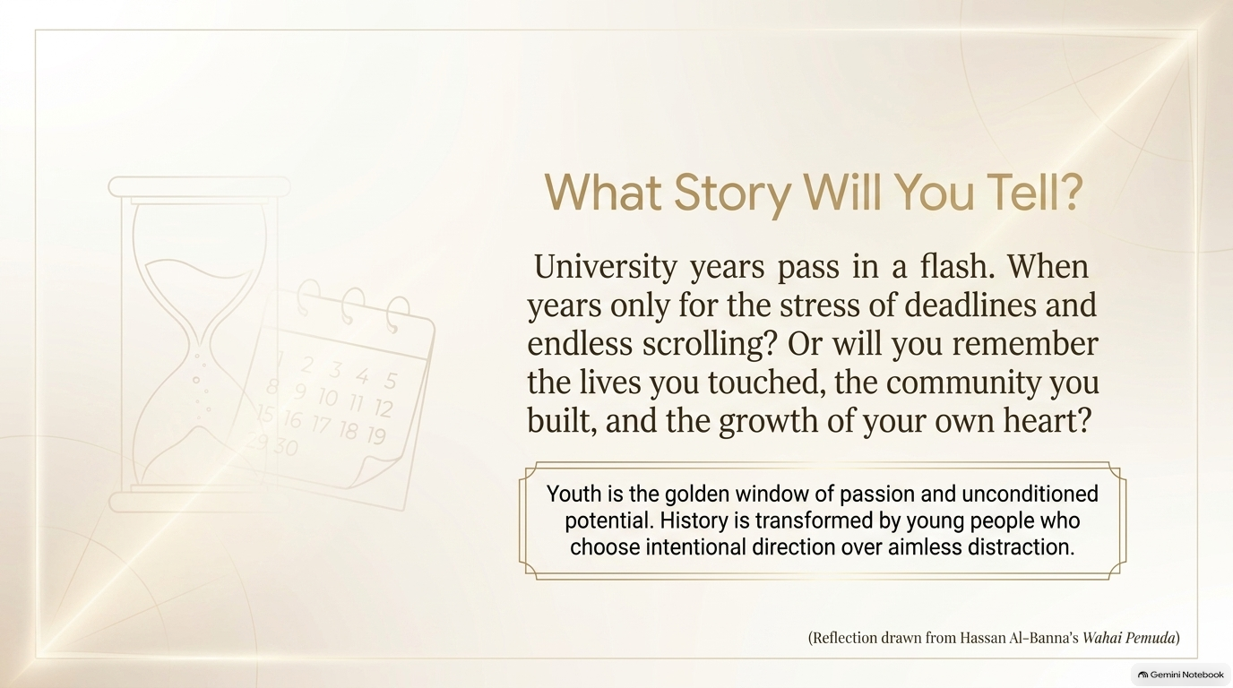

DEAR ME,
...
Notes:
A Letter to Your Future Self
Take 5 mins, and write a letter to yourself.
Picture yourself 3 or 4 years from now, wearing your graduation gown, standing right outside this campus building. You look back at your university years.
After 5mins......
In your letter, reflect....
Do you want to remember these years only as a blur of late-night cramming, assignment stress, and endless scrolling on your phone?
Or do you want to remember these years as the time your soul woke up?
The time you built real friendships, helped people, found your Ikigai, and grew closer to Allah?
The choice is made in the small decisions you make today."
---------------------------------------
"To wrap it all up:
oFrom Yasmin Mogahed, we learned to unhook our hearts from temporary stress and anchor them to Allah.
oFrom Dr. Hatta Shaharom, we learned to use the Quran as our psychological beacon when we feel lost.
oFrom Ikigai, we learned to merge our personal talents with what the world needs.
oAnd from Hassan Al-Banna, we learned that youth is our golden opportunity to turn intention into gentle action.
That is the shift from distraction to direction."

Slide 17
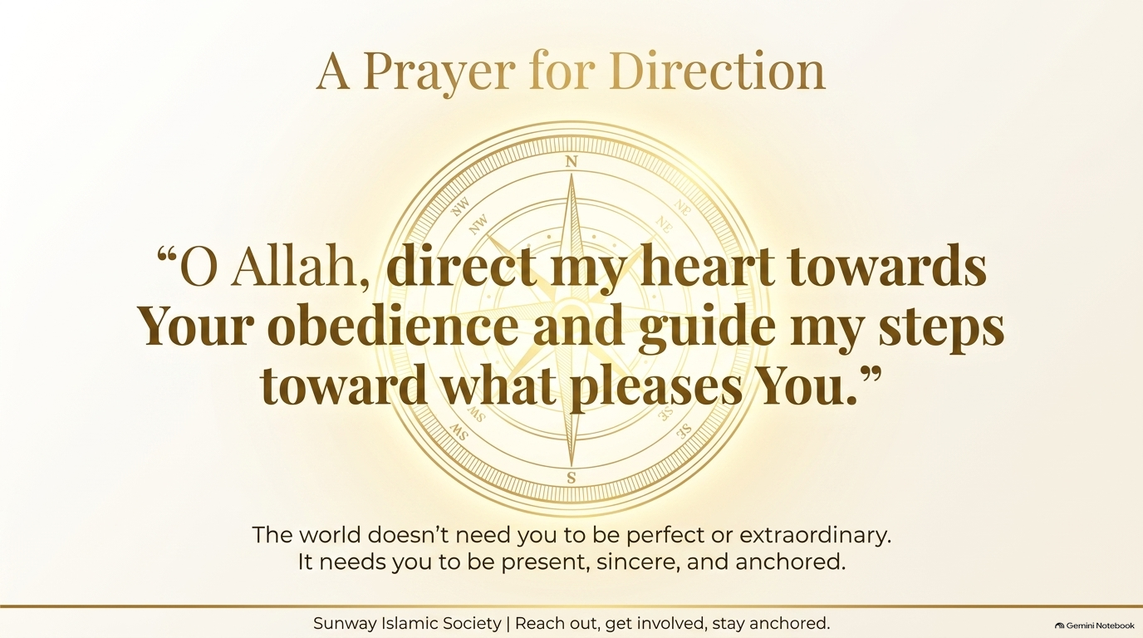
Notes:
Bismillah....
'O Allah, guide our hearts when we feel lost, clear our minds when we feel distracted, and use our talents, our youth, and our time to bring light to those around us. Bless our studies, ease our burdens, and grant us peaceful hearts.' Ameen. Thank you all so much for your warm attention."
Dear Sisters
"The world doesn't need you to be extraordinary or famous; it just needs you to be present, sincere, and caring.”

Slide 18

QUESTIONS?

